Slide 1
Annotated Bibliography

Slide 2
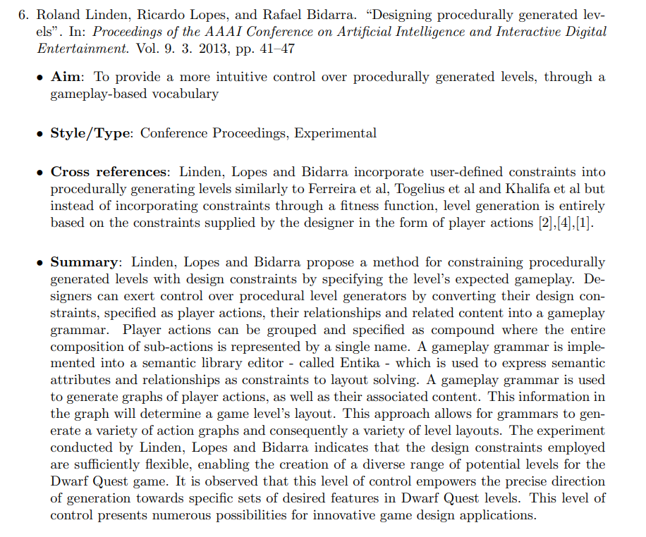
Introduction

Slide 3

Introduction
https://scholar.google.com/

Slide 4
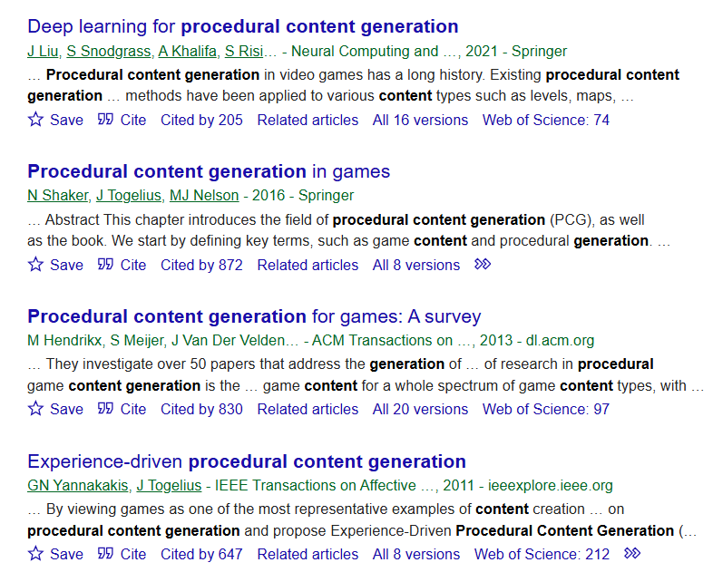
Introduction
You want to be looking for highly cited works from accredited venues

Slide 5
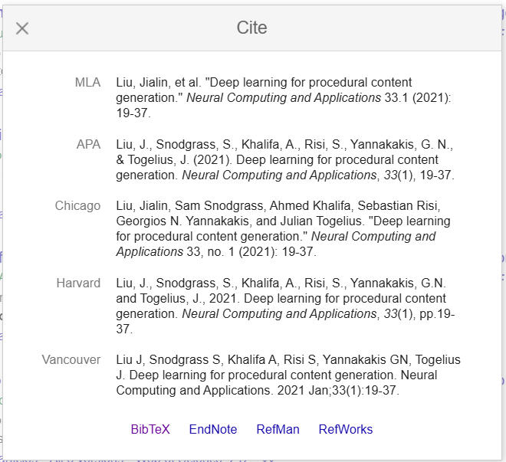
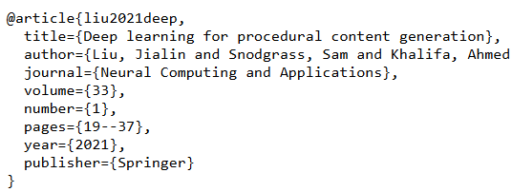
Introduction
Get the latex reference directly from the paper

Slide 6
Aim
Represents the overall objective of the paper
Needs to cover all the bases
Problem
Domain
Approach

Slide 7

Aim
Represents the overall objective of the paper

Slide 8
Aim
Represents the overall objective of the paper

Slide 9
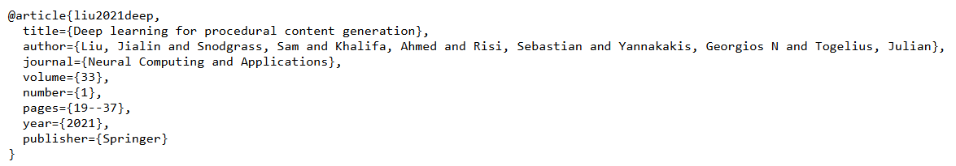
Style
Represents the type of publication
Conference / Journal / Book
Experimental / Theoretical
Let the Bib entry guide you

Slide 10
Cross Reference
Compare and contrast with the other papers
Differences / similarities
Need to image map connecting all your papers
Domain/Dataset
Limitations
Model / Algorithm
Problem

Slide 11
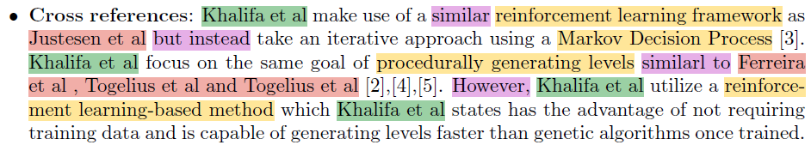
Cross Reference
Primary Paper
Linked Papers
Comparative Wording
Similarities / Differences

Slide 12
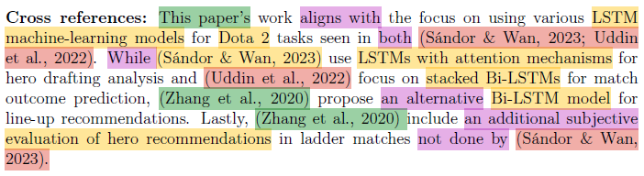
Cross Reference
Primary Paper
Linked Papers
Comparative Wording
Similarities / Differences

Slide 13
Summary
Problem being addressed
Proposed method / core contribution
Domain of testing
Key results
Limitations of
Key takeaway

Slide 14
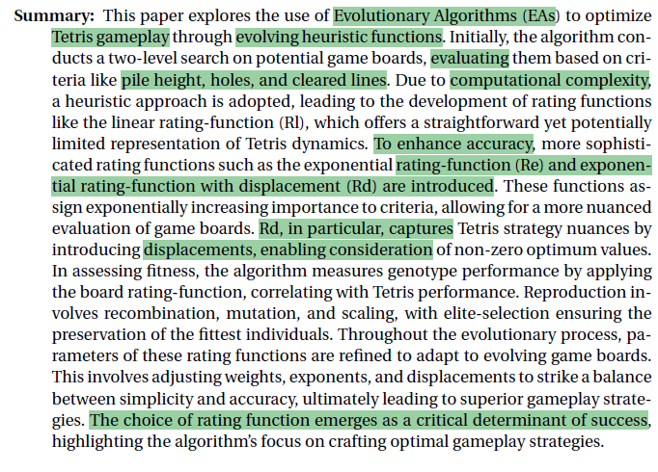
Summary
Problem being addressed
Proposed method / core contribution
Domain of testing
Key results
Limitations of
Key takeaway

Slide 15
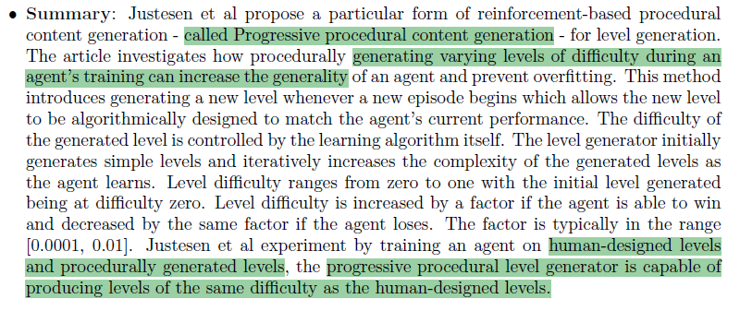
Summary
Problem being addressed
Proposed method / core contribution
Domain of testing
Key results
Limitations of
Key takeaway

